Slide 1
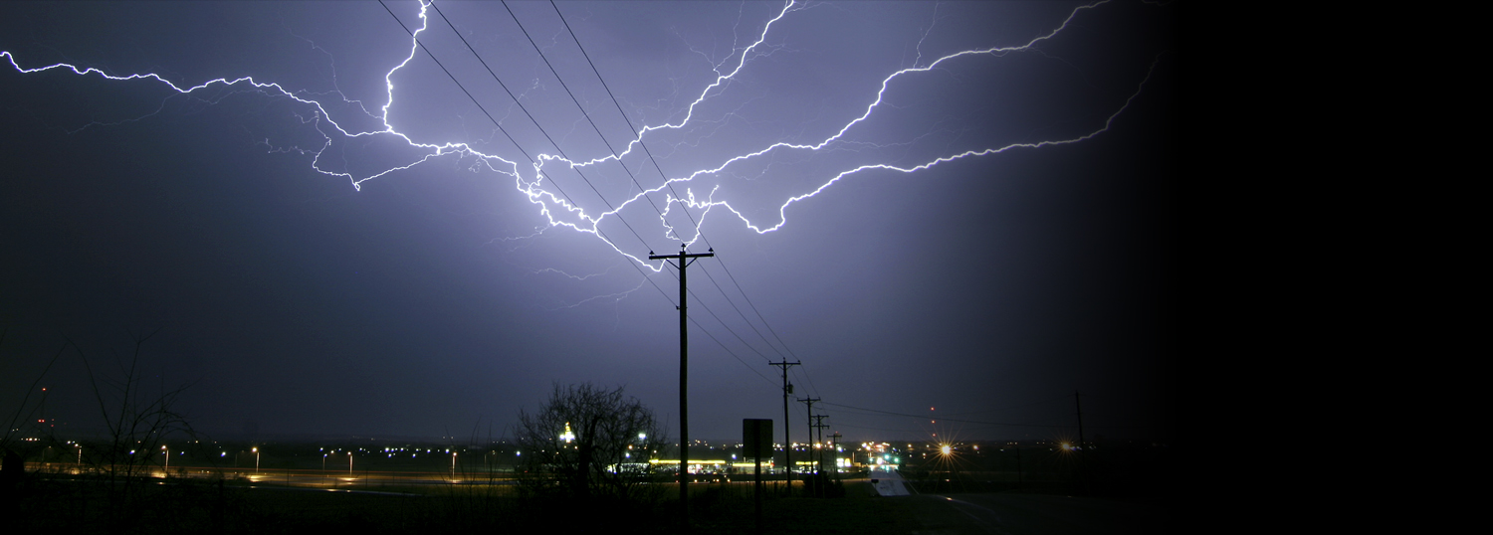
BE PREPARED
Taking Care of You and Your Family
Notes:
PRESENTER NOTE: this presentation includes reference to the following handouts. Try to have them available for each person attending the session.
2 Weeks Ready
Prepare in a Year
Emergency Kit list

Slide 2
Training Overview
Why is preparation important?
  Your role
  Steps to Preparation
Be Informed
  Dangers in Louisiana
Make a plan
  Children?
  Are there any special needs?
  Practice the Plan
Build a kit
  Maintain and update your kit
Get Involved
Resources
Notes:
Today we are going to talk about being prepared for emergencies and disasters, and some of the important stops in the process. Because we care about our families we want them to be prepared. Also as employees of the Louisiana Military Department or members of the Louisiana National Guard we need to have our families prepared because the citizens of Louisiana are counting on us to do our jobs during disasters. There are numerous sources for guidance about preparedness and plenty of messages promoting preparedness.

Slide 3
“The First 72 is on You”
Why Not 2 WEEKS?
Which would you think would better support your family?
“It is not a matter of if, it is a matter of when”
Notes:
They have a saying . “The first 72 is on You”! It is an idea design at minimum to get you and your family the basic supplies that you can survive off of until help arrives. BUT what if that help takes longer to get to you, are you ready?
The reality is that there are hazards in this state that could cause major destruction. While the nation is ready to bring help when we need it, the scope of damage may prevent help from getting to everyone quickly. We need to be prepared to be self-sufficient for at minimum 14 days, and even 30 days would be wise. You will find that many of the national sources of preparedness material, such as Red Cross, FEMA, Ready.gov and even Ready Army promote 3 days of preparedness,
“The first 72 is on You”. Why are we promoting 14 days of preparedness supplies? Why do you think? WANT TO KNOW MORE? (refer to the 2 Weeks Ready flyer)

Slide 4
Your Role
In a disaster, you may be a victim, but you are also a vital part of the response, critical to your family, neighbors, fellow Guard members, and the citizens of Louisiana.
Immediately following a catastrophic disaster, National Guard Service Members are mobilized.
Upon mobilization stabilize family members and report as follows:
First report to your assigned unit/armory, or per your unit’s SOP.
If you cannot get to your unit/armory report to the nearest Guard facility.
If you cannot get to a Guard facility report to the nearest Emergency Operations Center or Incident Command.
Upon arrival to any location announce your status and availability. Ensure you contact your unit advise them of your location.
Notes:
So what is expected of you following a disaster? First thing is taking care of your family, they are your number one priority, that is why we are here today to discuss preparedness. Once your family is stabilized you need to try to contact your chain of command to see where or if you need to report.
After a catastrophic disaster, like an earthquake, communication system working will be seriously overloaded. Do not expect a phone call, text or email. Just imagine if the ground shakes for 5 minutes you are most likely needed. If possible report to your unit or armory. If you cannot get to your assigned location go to the nearest armory. If you can’t get to an armory go to your local Emergency Operations Center. Do you know where it is? Do you know your county Emergency Manager? Is your city large enough to have an EOC? If you can’t get to an EOC you may be able to get to a fire station or law enforcement office. You need to get to one of these locations so that you can report in. Local responders have communication capabilities that will allow you to contact your unit or JDOMS, so that you can report your status and availability. There is a LANG representative at GOHSEP.

Slide 5


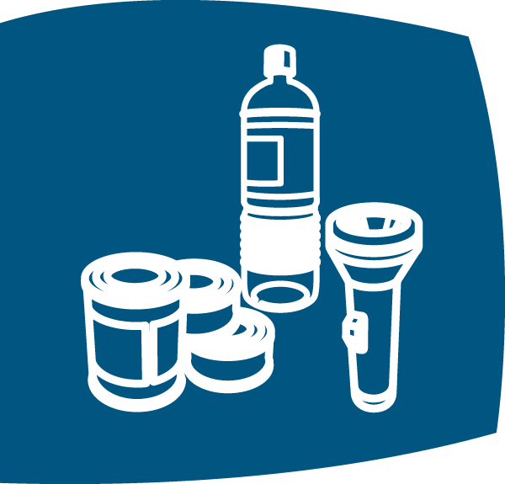

Steps to Preparation
Learn the steps to getting prepared:
Be Informed
Make a Plan
Build a Kit
Get Involved
Notes:
Your family is counting on you to make sure you are prepared for the whole range of emergencies and disasters AND the citizens of Louisiana are counting on you to do your job during those events. Let’s talk about these steps towards preparedness. As you watch this video note the differences and similarities. Each side of the screen represents two different time periods.

Slide 6

NO Time Like Now to Get Ready!
Ready.Gov PSA - "The Day Before"

Slide 7
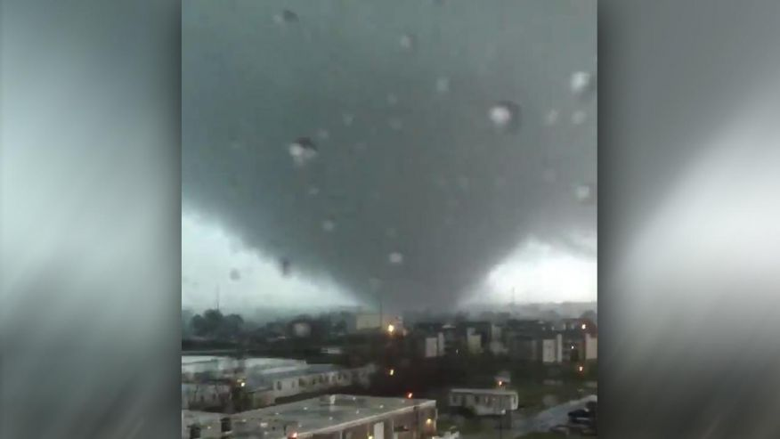
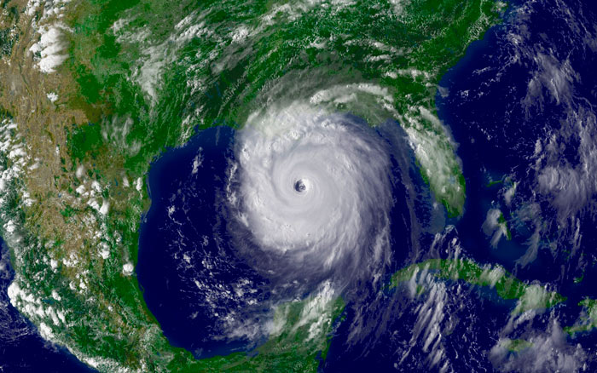
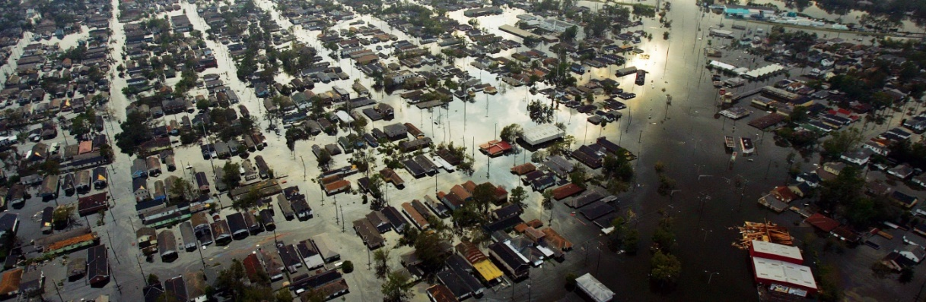
Be Informed
Know the Risks – Know Your Area
The consequences of emergencies can be similar, but knowing the risks in your area can help you better prepare.
Types of Disasters in Louisiana:
Hurricanes
Flooding
Tornadoes
Earthquake
Fires
Winter Storms
Infectious Disease
Terrorism
Hazardous Material Spill
Notes:
It is important to know what hazards are in your area. We have already talked about several disasters and a number of other hazards in our state. Do you live in a lahar zone? (A lahar is a type of mudflow or debris flow composed of a slurry of pyroclastic material, rocky debris, and water) A flood plain? Near a transportation route that carries hazardous materials? We have power disruptions due to weather several times a year. Infections disease professionals remind us regularly that the next pandemic will be devastating. And we know terrorism is a real threat anywhere. While we have a variety of threats and hazards man impacts and consequences are common across the board.

Slide 8
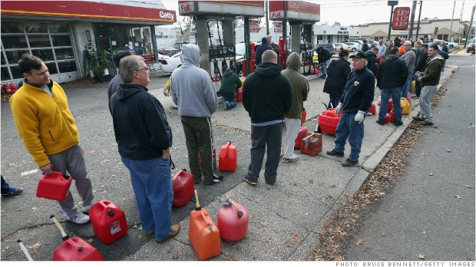
What Could Really Happen?
Buildings
Utilities
Telephones
Stores
Drug Stores
Bank ATM
Roads
Gas stations
Hospitals
Airports
Notes:
What are all of these people waiting for? Why do they need that? (generators, chain saws, etc.)
The things we take for granted every single day will not be the same after a major disaster. Even a minor disaster can impact a few of these areas. How are these things impacted by a disaster? Consider how many days you could go without access to these things. Small wood structures may survive an earthquake, but larger buildings could experience damage leaving them inaccessible, and even if they don’t have visual damage until they are inspected you can’t know for sure.
Buildings/Homes (collapse or damaged)
Electric power (out/intermittent)
Gas, water, and sewer (out/damaged)
Telephones (lines busy, totally out)
Stores (closed - limited food, water, etc.)
Drug Stores (closed, out of medicines)
Bank ATM (no electricity, will not work)
Roads (impassable – wrecks or debris)
Gas stations (no electricity – no gas)
Hospitals (overflowing – too damaged)
Airports (closed or damaged)

Slide 9
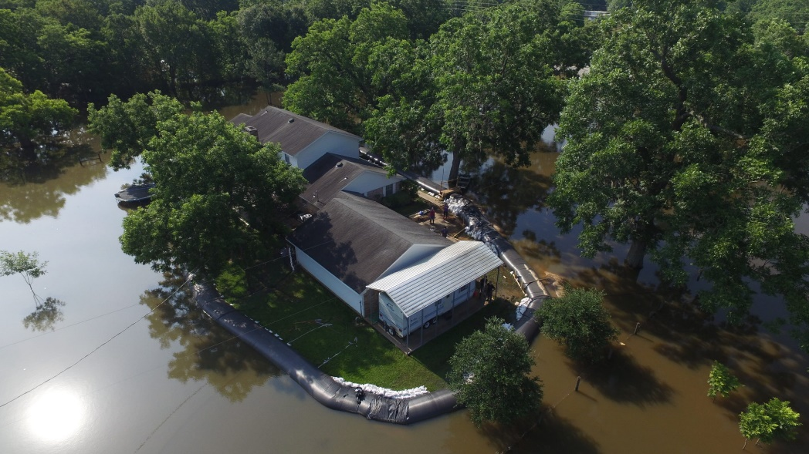
Why is Preparation Important?
Have you ever thought about
how to prepare for an emergency?
How would you:
Cope without power or water?
Take care of your pets?
Contact your family if you were at work or school?
Look after your family for 3 days? 7 days? 14 days?
How would you send and receive information about
what is happening?
Notes:
Life is busy right? We often intend to spend time planning, but there is always so much to do. We procrastinate and fail to make preparedness a priority. It doesn’t have to be a major disaster to cause disruption to our lives. A common winter storm could cause a power outage. A spill or damage to the water system could make our drinking water unsafe. A hazardous materials accident could require evacuation, are you prepared to take your pets with you? If a disaster occurs on a regular week day while you and your spouse are at work and the kids are at school, how will you find out if everyone is okay? Will you care about anything else until you know that your family is safe? (if time allows explain item #2 on the Prepare In A Year flyer, Out of Area Contact) The whole family needs to be involved in planning and they need to know the plan.

Slide 10
Make a Plan
FEMA- “Seat of Your Pants"

Slide 11
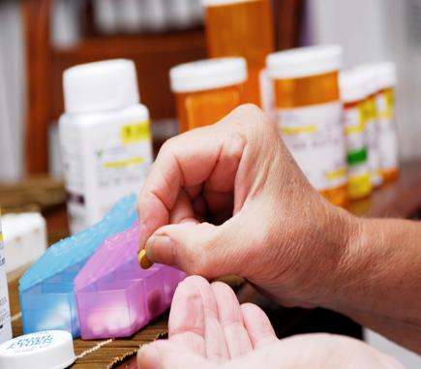
Planning Considerations
Special Needs:
Unique needs
Infants
Disabilities
Medical devices
Notes:
Every Family is unique and our life circumstances can change. Be sure to update your emergency plans and kits to reflect your current needs, even if the change is temporary.
Infants require additional time and supplies, especially during emergencies.
Remember that people with long-term or temporary disabilities must take a proactive approach to ensure that their safety needs are included in all emergency planning.
Those with physical disabilities can have complications during emergency evacuations.
Those with visual, hearing or mental disabilities may have difficulty leaving familiar surroundings.
Others with medical conditions may be dependent on devices or medications that need to travel with them.

Slide 12

Planning Considerations
Pets:
“Pet-friendly”
shelters/hotel
Extra pet food and water
How will you transport
your pets?
Notes:
Our pets are important members of our family. Plan for them as well. Some shelters do allow pets, but they must be in carriers. Some pets have medications or particular food they require to be healthy. These events can be stressful for them as well, making sure to have things that are familiar for them will help keep them calm. Who has pets? What would be important to them if you had to take them out of your home?

Slide 13
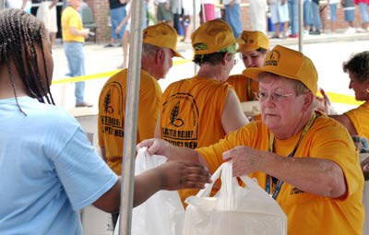
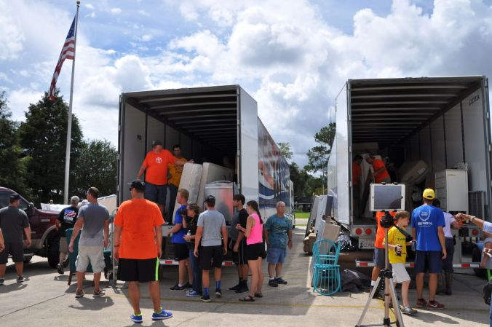
Religious Support in Emergencies
Why think about religious support?
  Churches, Synagogues, Mosques, and other places can be centers of emotional and spiritual support for those affected
  Chaplains, pastors, priests, imams, and rabbis can help civilian population with counseling
  Religious groups often offer meals, first aid, counseling, and other “front line” type support
  Religious properties can also provide staging areas for military personnel and equipment (ask for permission first!)

Slide 14
Build a Kit
Notes:
How many kits do we need to have? (refer to the sheet and item #7 on Prepare in a Year) Home, Car, Work, Under the bed etc.
These kits will enable you and your family to respond to an emergency more quickly.
Your various emergency kits will be useful whether you have to evacuate or shelter-in-place.
Think reusable and multi-use. A metal bowl can do double duty as a cup and saucepan. A brightly colored poncho can be used as water repellent clothing, and two together can create a temporary shelter.
Be sure to rotate your items periodically, ensuring nothing is expired when the need comes.

Slide 15
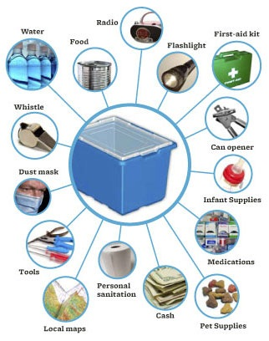
Get a Kit
Notes:
What do you think of the prepacked kits? (a place to start, but needs to be personalized for unique needs) What needs to be in a kit? (If possible use chart paper to write down their list, then fill in whatever is missing)
(Pick up examples of the following items as they are mentioned, talk about various options for powered items (flashlights, radios) crank, solar collector, etc. Water filtration, gross contamination ie. Grit filters and microbes UV light)
Basic items to consider for a emergency kit cont’d:
Flashlight, NOAA (National Oceanic and Atmospheric Administration) battery-powered weather radio, battery-powered cellphone charger and extra batteries or hand crank powered devices
First aid kit and prescription medications
Sanitation supplies such as moist towelettes, disinfectant and garbage bags
Important documents in watertight packaging—personal, financial and insurance—store copies in a separate location (safety deposit box, relatives, or trusted friend)
Your family emergency plan, local maps and your command reporting information
5-Gallon bucket with plastic bags for use as a portable toilet
Cash in small denominations
Many other items could prove helpful:
Fire extinguisher
Any tools needed to turn off utilities
Matches in a waterproof container
Sleeping bags or other bedding
A weather-appropriate change of clothes for each person
Books, games, puzzles, toys and other activities for children
Batteries and cell phone chargers

Slide 16
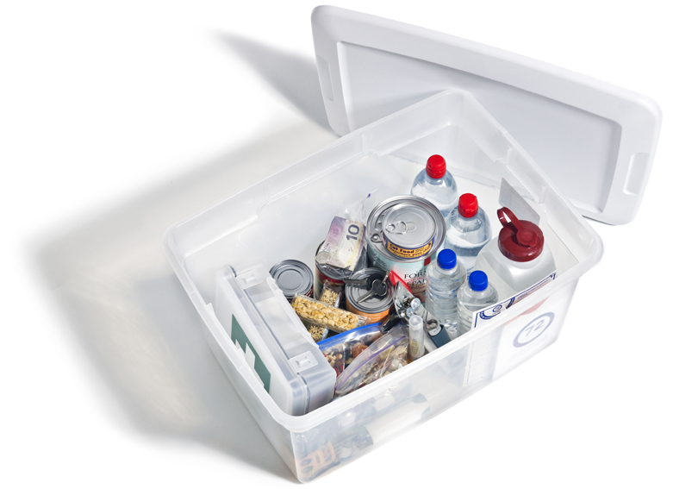
Emergency Kits
Fast fact:
Although the majority of Americans believe
that having an emergency plan and
emergency kit are important, only
a small minority have actually created them
Notes:
Why is this true? (Pause to let participants read the slide themselves, ask for their concerns, possible responses below)
Cost (building the kit over several months, make kit items gifts at Christmas and birthday, buy bulk (if you eat the same soup and cups of applesauce 10 days in a row you will be happy to have it during a disaster, at PODS all they have for you is MREs)
Food expires (use the food as your annual food drive donation and restock your disaster supplies)
Can’t get extra medication prescriptions filled (order at 28 days and after 7 months you will have your 14 day supply, remember to rotate that supply)

Slide 17
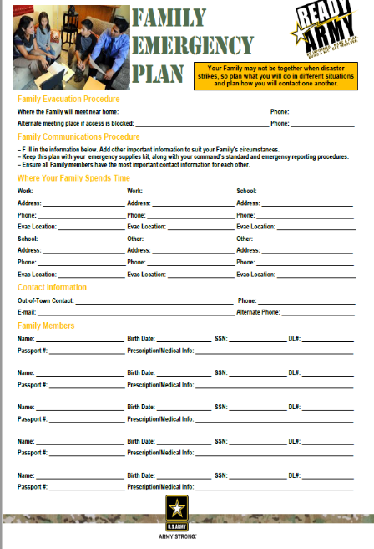
Get Started – Make Steady Progress
You aren’t prepared — until you make a plan.
Use your resource checklists and forms as guides
Photocopy your plan
Keep copies of your plan in safe and memorable places
Make sure everyone in the family understands the plan
Choose an out-of-town contact person
It is only a piece of paper until you practice your plan.
Notes:
(If these are available for distribution mention where they are located) This form is a good place to start, collecting important information, having the conversation with your family. Use whatever guidance works for you, Red Cross, FEMA, Ready Army etc. BUT remember we need to prepare for 14 days. When your plan is ready then you need to test it. How do we test things? (Ask for their ideas, share these: fire alarms, home evacuation, family meet up [send a message to family members “THIS IS A DRILL, we can’t return to our home. Go now to our “away from home” meeting place. We will go out for pizza when you get there.] Pack for a camping trip, use your disaster food supplies, just as you climb into the car say “THIS IS A DRILL we are evacuating our home and don’t know how long we will be gone, you have 5 minutes to get what is most important to you, GO” Drills can be fun, but can cause worry for younger members of the family. On YouTube search for Disaster Dodgers, a set of 5 FEMA videos with kids talking to kids about preparedness, these are fun, but provide great information.

Slide 18

Practice the Plan

Slide 19


Get Involved
Louisiana National Guard
At home
  Organize your neighbors
    they help when you are away
  Meet your local EM
At work (civilian)
  Pre-coordinate with your Commander
Notes:
LANG: Yes, as a member of the Louisiana National Guard you are already involved. And because of this your neighbors, friends and co-workers will look to you during a crisis and you can provide that same leadership in preparedness as well.
HOME: One way you can be a leader is to help your neighbors prepare for disasters. If your neighborhood is organized they become better support for your family when you are away. Also your community may offer CERT training. Attending CERT training together as a neighborhood group can build strong partnerships that will work smoothly in emergency and disaster situations.
LOCAL EM: During a major disaster if you are unable to get to a National Guard facility you are expected to go to a local EOC or Incident Command location. Meet your local EM now and introduce yourself. If you are interested in a career in EM in the future connections at the local level could lead to experience for your resume.
WORK: Some civilian jobs such as First Responder, could prevent Guard personnel from mobilizing post-EVENT. If you work in one of those fields discuss the options with your civilian employer and communicate AHEAD of time with your Commander. If you will be needed at your civilian position let your Commander know.

Slide 20
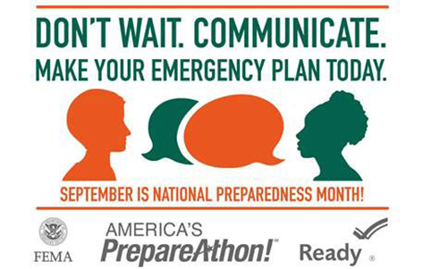
Steps to Preparation
Remember the steps to getting prepared:
Be Informed
Make a Plan
Build a Kit
Get Involved
Notes:
We all need to prepared for a wide range of natural and man-made hazards. Preparedness takes time and effort. Start today. Involve your family. Find tools that work for you. Keep working on it and once you are done practice and drill. Remember to keep your plans and kit updated. Get a Game Plan

Slide 21

Resources
Michael Green, EM Program Coordinator
  michael.s.green39.mil@mail.mil
Ready Army
  www.ready.army.mil
LA Governor’s Office of Homeland Security & Emergency Preparedness
  http://gohsep.la.gov/
Louisiana Military Department Emergency Management Web Site
  http://geauxguard.la.gov/resources/emergency-management/
Notes:
From Ready Army, to Louisiana National Guard, to GOHSEP, to Red Cross, to Ready.gov
There are common themes and examples across all sources of preparedness information.
But remember in Louisiana we prepare to be self-sufficient for minimum 72 hours. Why Not 2 WEEKS!!!!

